Slide 1
Factors Affecting Opioid Treatment
Mohammed Ahmed, Jacob Gibbs, Ethan Nguyen, Erin Starkey

Slide 2
Opioid Use
Drugs
Health Risks
Scope
Heroin
Painful Withdrawal
2 million Americans addicted
Pain Relievers
Overdose
33,000 opioid OD deaths in 2016
Death
Over 50% of all OD deaths are opioids
Drug OD is #1 cause of death under age 50

Slide 3
Project Scope
Question
What factors most affect whether or not an opioid user receives treatment?
Objective
To provide insight on who is not currently receiving the treatment they need and therefore where treatment outreach/support should be focused

Slide 4
Methods
Data Selection
Dimension Reduction
Analyze Variable Relationships
Insights
National Survey on Drug Use and Health
Variable Selection
Define Target Variable
Relationship
Visualizations
Regression
Indications of opportunity for better treatment

Slide 5
Variables Analyzed
Target Variable
Has the individual ever received treatment for heroin or pain reliever misuse? (Yes/No)
Input Variables
Access to Resources
Demographics
Usage History

Slide 6
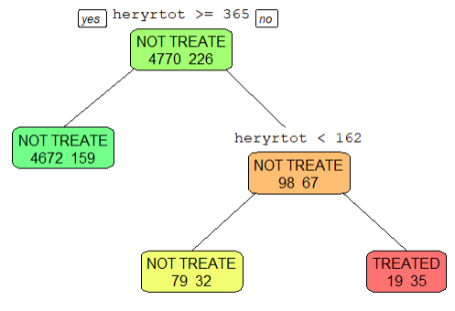
Decision Tree
Individuals who use heroin LESS than 162 days a year often do NOT participate in getting the treatment they need
heryrtot= Total # of days the respondent used heroin in the past year
**first rule sorts out applicants that heroin use is NOT applicable to

Slide 7
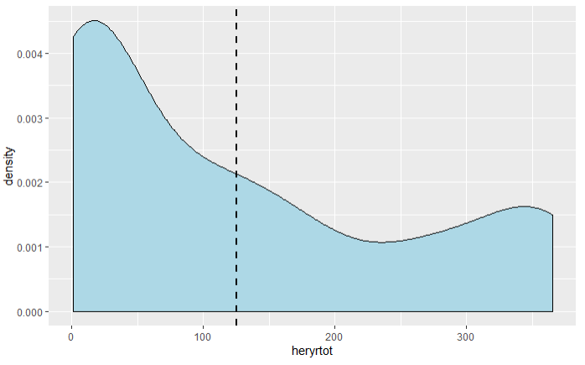
Frequency of Use
Density and Average Frequency of Heroin Use

Slide 8
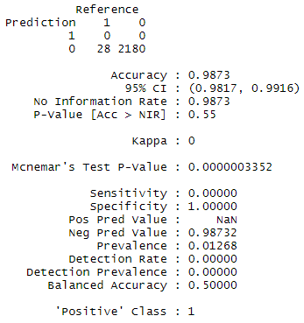
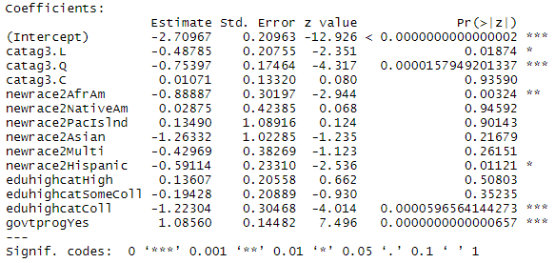
Logistic Regression
Notes:
Could put types of treatment, and then also what percentage of users actually recieve treatment because we are trying to explain that low number

Slide 9
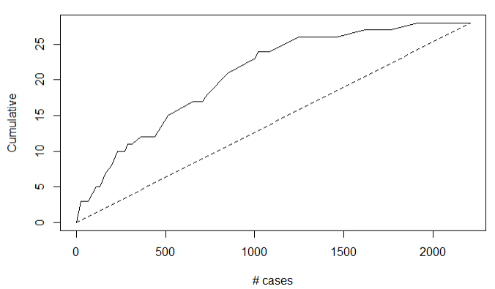
Logistic Regression
Lift Chart
Notes:
Could put types of treatment, and then also what percentage of users actually recieve treatment because we are trying to explain that low number

Slide 10
Logistic Regression
Significant Variables
Younger and middle aged users are LESS likely to be treated
African American and Hispanic users are LESS likely to be treated
Users with a college degree are LESS likely to be treated
Users who participate in government programs are treated MORE often
Notes:
Could put types of treatment, and then also what percentage of users actually recieve treatment because we are trying to explain that low number

Slide 11
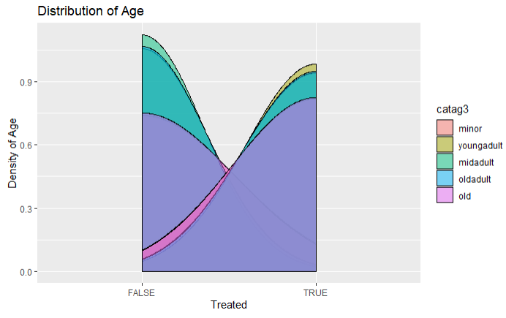
Significant Outcomes
Younger and middle aged users are LESS likely to be treated
Notes:
Could put types of treatment, and then also what percentage of users actually recieve treatment because we are trying to explain that low number

Slide 12
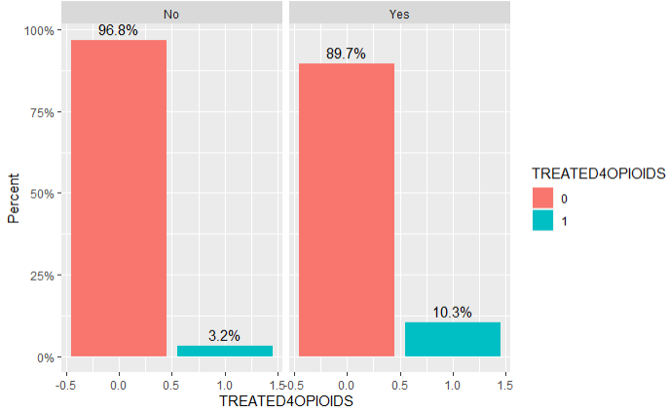
Significant Outcomes
Participation in a Government Program (Yes/No)
Users participating in government programs are MORE likely to receive treatment
Notes:
Could put types of treatment, and then also what percentage of users actually recieve treatment because we are trying to explain that low number

Slide 13
Conclusion
Likelihood of Receiving Treatment:
Increased: Decreased:
Use heroin nearly every other day
In government program
Younger and Middle Aged
African American or Hispanic
Have a college degree
Notes:
Could put types of treatment, and then also what percentage of users actually recieve treatment because we are trying to explain that low number

Slide 14
References
US National Library of Medicine: https://ghr.nlm.nih.gov/condition/opioid-addiction
National Survey on Drug Use and Health, 2017 (NSDUH-2017-DS0001)https://www.datafiles.samhsa.gov/study-dataset/national-survey-drug-use-and-health-2017-nsduh-2017-ds0001-nid17939

Slide 15
Comments or Questions?

